Slide 2
DINOSAURS

Slide 3
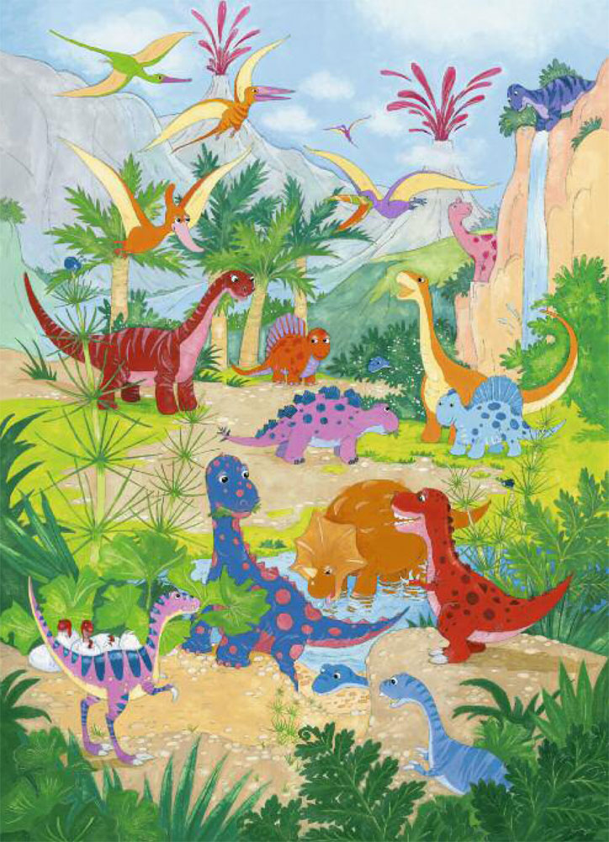
What is a Dinosaur ?
Dinosaurs were reptiles which lived millions of years ago, long before there were any people.
Dinosaurs lived on the earth for over 100 million years but then they mysteriously became extinct.

Slide 4
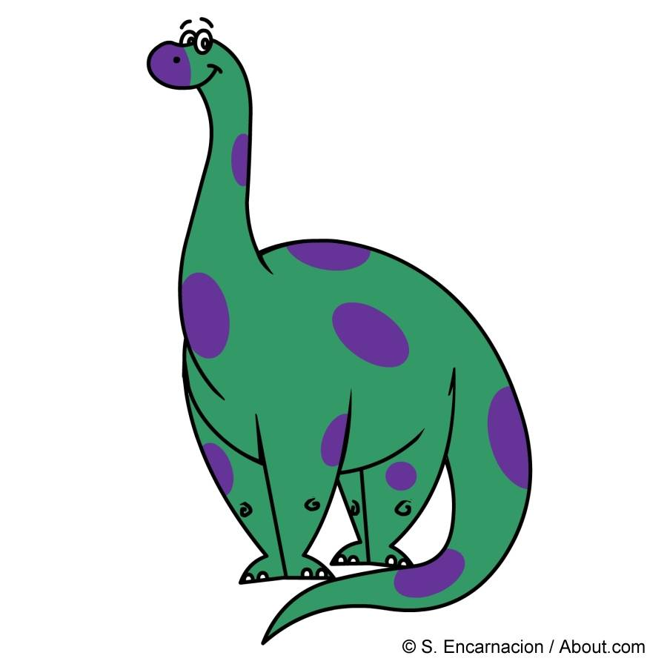
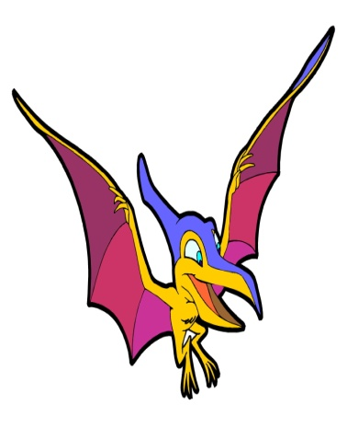
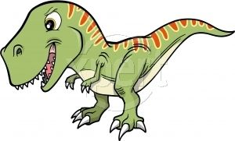
What typest of Dinosaurs were there?
There were lots of different kinds of dinosaurs that lived at different times.
Some were HUGE……
Some dinosaurs could move along quite quickly on two legs.
… and the other were much smaller.
Others walked on four legs in a very slow and clumsy fashion.

Slide 5
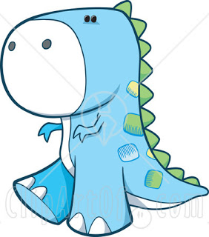
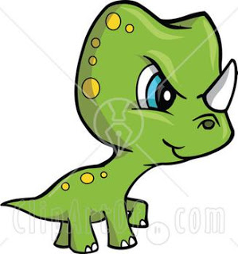
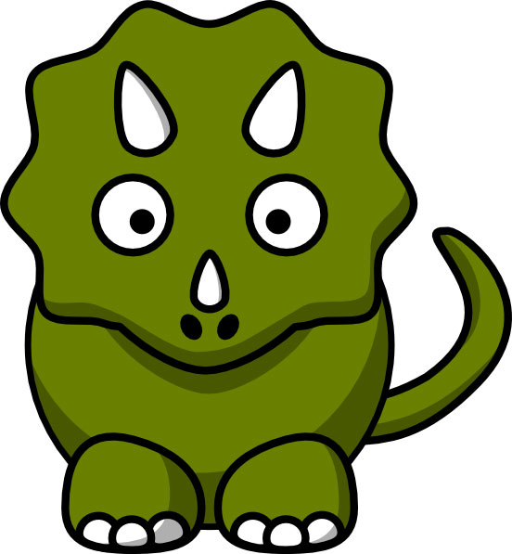
All of the dinosaurs looked quite different. They could have...
armor plating,
horns,
bumpy skin,
wings.
There were lots of other differences too!

Slide 6
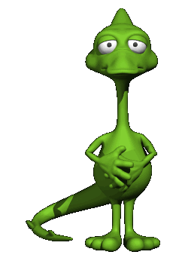
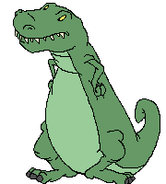
Dinosaurs reproduction
All dinosaurs lay amniotic eggs with hard shells made mostly of calcium carbonate. Eggs are usually laid in a nest. Most species create somewhat elaborate nests, which can be cups, domes, plates, beds scrapes, mounds, or burrows.

Slide 7
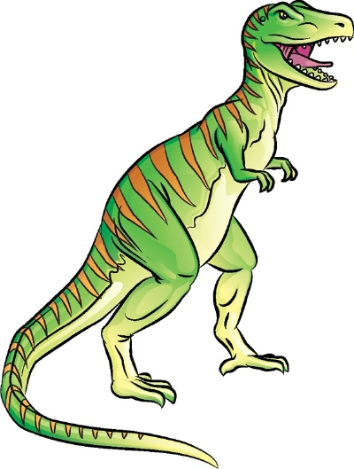
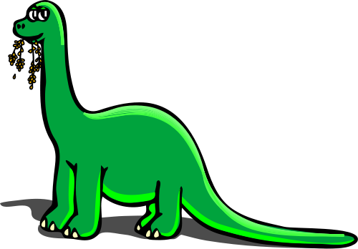
What did Dinosaur eat?
Different dinosaurs ate different things.
Dinosaurs like the diplodocus ate leaves: these dinosaurs are called herbivores.
Dinosaurs like the velociraptor, or the T-Rex, ate meat: these dinosaurs are called carnivores.

Slide 8
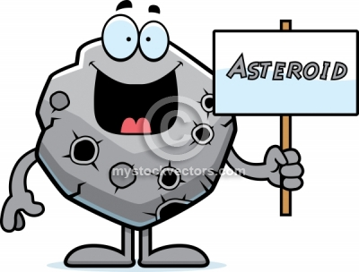
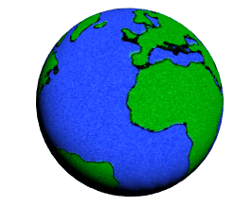
Why did they become extinct ?
Nobody knows exactly what happened to the dinosaurs.
Some people believe that an asteroid caused changes on the earth that the dinosaurs could not adapt to.

Slide 9
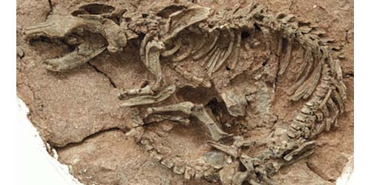
What is left from Dinosaurs ?
All that is left of the dinosaurs are fossils. These are dinosaur bones that have been discovered in the earth and rock.

Slide 10
THANKS FOR YOUR ATTENTION

